Slide 1



NM391 The Ones n Zeros

Slide 2
SMART INDIA HACKATHON 2020 Finale
Organization Name :Indian Space Research Organization (ISRO)
Problem Statement: Reconstruction of missing data in Satellite Imagery
PS Number : NM391
Team Name : The Ones n Zeros
Team Leader Name : Vignesh Charan Raman
College code : 1-3713389121

Slide 3
Problem Statment
NM391-ISRO Reconstruction of missing data in Satellite Imagery
Short Wave Infra-Red(SWIR) detectors used in satellite imaging cameras suffer from dropouts in pixel and line direction in raw data. Develop software to reconstruct missing parts of a satellite image so that observers are unable to identify regions that have undergone reconstruction

Slide 4
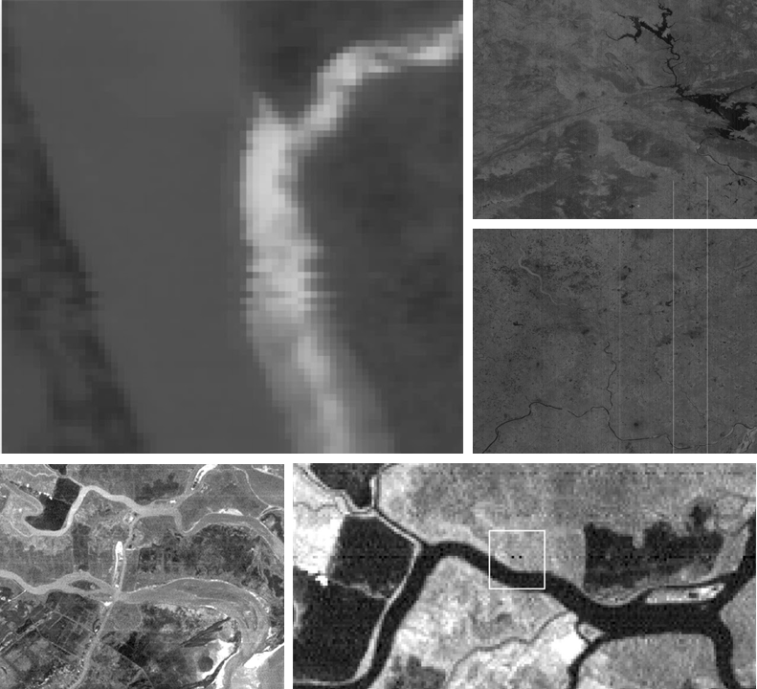
TYPES OF ERRORS
Random bad pixels (shot noise).
Line-start/stop problems.
Line or column drop-outs.
Partial line or column drop-outs.
Line or column striping

Slide 5
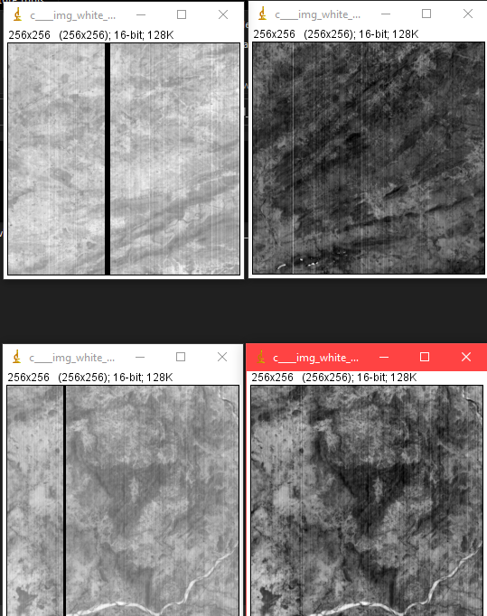
Proposed Solution
The method we intend to implement relies on the algorithm namely DC-GANs to Reconstruct missing parts of images effectively.
The Training Dataset provided to the Algorithm learns the correlation between the pixels of the image. The nearby pixels are analysed (spatial analysis) and the correlation is applied to fill the incomplete data and the most homologous result which is the final reconstructed image is given as an output.
Since the proposed algorithm uses pristine analysis, the reconstructed Image promises high accuracy with almost no room for error.

Slide 6
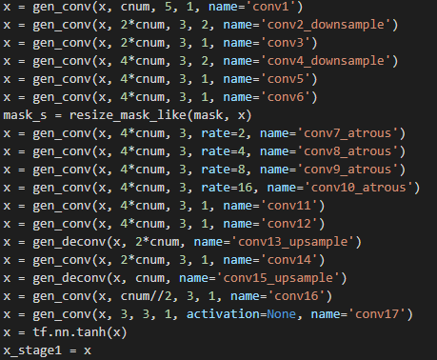
Architechture of GAN
Generator
Stage 1
Normal Feed forward NN
With dialated Convolutional Layers (used for expanding the kernels to extract the features nearby the reconstructing regions)

Slide 7
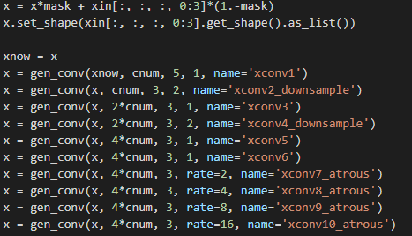
Architechture of GAN
Generator
Stage 2
Attention Branch
Contextual Attention or making the algorithm context aware.
The features extracted from dialation layer are used here for making the algorithm analyze the regions.

Slide 8
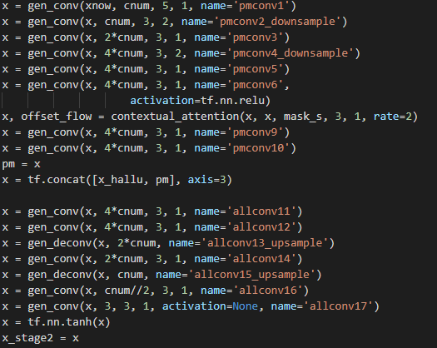
Architechture of GAN
Generator
Stage 2
All Layers are aggregated and
fed into single decoder for obtaining the output.
deconvolution to reconstruct the generated patches with contextual patches.

Slide 9
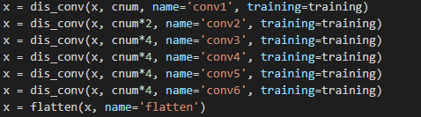
Architechture of GAN
Discriminator
A Normal Discriminator is attached to the 2 staged Generator

Slide 10
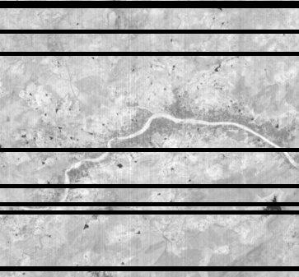
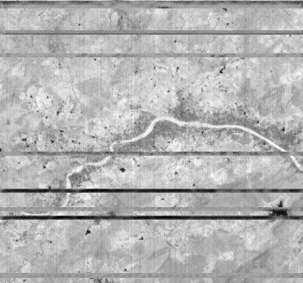
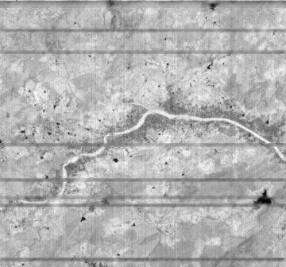
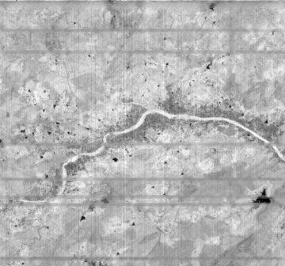



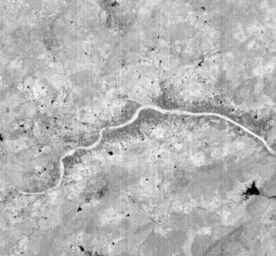
Output
Input
Output from Gans 1st
generation (61epoches)
Output from New Gans model
2 staged (82 epoches)
New Gans (118 epoches)
New Gans (201epoches)
New Gans (237epoches)
New Gans (359 epoches)
Original Ground Truth
Image

Slide 11
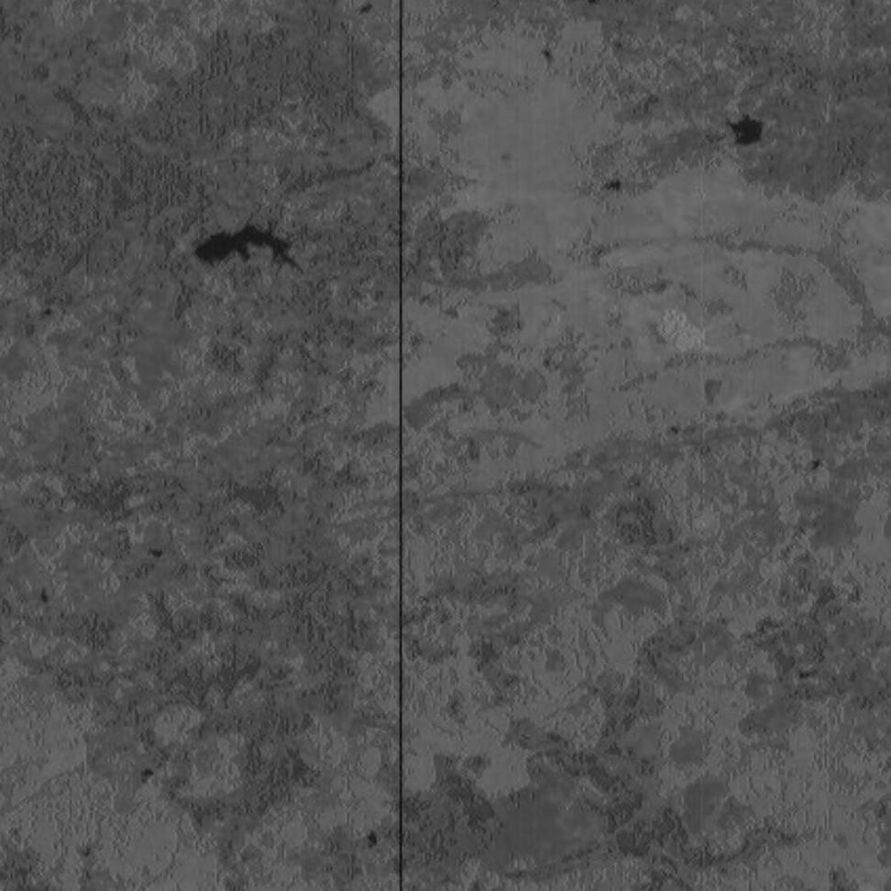


Generative
Inpainting
By using 2 Staged GAN
algorithm which is robust to calculate the pixel
values of missing regions.

Slide 12
Results
Similarity Index - SSIM values :
1. Original vs input : 0.9314753871768957
2. Original vs New Gans algo with new training data (359 epoches) : 0.9996847497074818
3. Original vs New Gans algo with new training data (82 epoches) : 0.9986725530035611
4. Original vs Old Gans algo with old training data : 0.9942820439040533
5. Original vs OpenCV reconstructed output : 0.9963796319465636

Slide 13
Citations
Title= Free-Form Image Inpainting with Gated Convolution
author=Yu, Jiahui and Lin, Zhe and Yang, Jimei and Shen, Xiaohui and Lu, Xin and Huang, Thomas S
journal=arXiv preprint arXiv:1806.03589

Slide 14
THANK YOU

